Slide 1

Java Language Environment

Slide 2
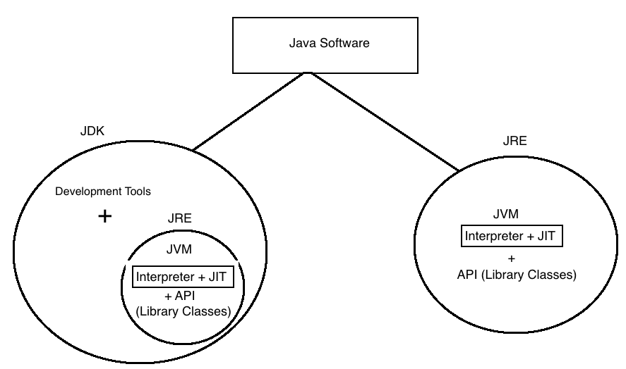
Java language Environment

Slide 3
Java Software
JDK stands for Java Development Kit. JDK Provides environment to develop and run Java Application.
We install JDK on Developer machine.
JRE stands for Java Runtime Environment. JRE provides Environment to only run Java Application.
We Install JRE on Client Machine

Slide 4
Difference between JDK, JRE, JVM, JIT
JDK

Slide 5
JDK
JDK stands for Java Development Kit.
It provides Development Tools( program preparation related small small softwares like Compiler, Decompiler, Debugging, Developing Documentation, Preparing Jar files etc) and runtime environment.
Using JDK we can develop, compile and execute new applications and we can modify existing applications.

Slide 6
JRE
JRE stands for Java Runtime Environment.
JRE does not provide any development tools. It contains only JVM.
We can only execute already developed applications.

Slide 7
JVM
JVM stands for Java Virtual Machine.
It is a java Platform. It provides interpreter and JIT using which we can run java byte code by converting them into machine language.
You can run Java Program Line wise Line

Slide 8
JIT
JIT stands for Just in Time Compiler.
It is responsible to help Interpreter for executing java byte code fast.
Basically it improves the performance of java program

